Slide 1

HTML animation
GIFs

Slide 2
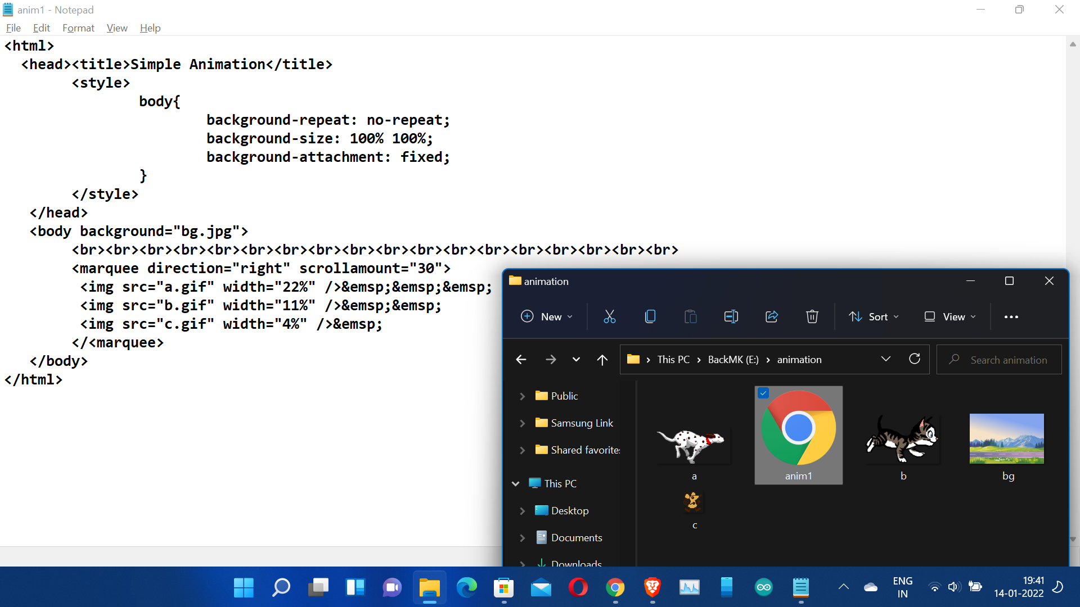
Location of the Image and html files

Slide 3
